Slide 1
Capstone Project
Applied Data Science Capstone by IBM Coursera

Slide 2
Table of contents
Introduction
Data
Methodology
Results and Discussion
Conclusion

Slide 3
Introduction
An Example to fetch postal code information of Canada similar to course assignments.
The purpose of this Project is to help people in exploring better facilities around their neighbourhood.
It will help people making smart and efficient decision on selecting great neighbourhood out of numbers of other neighbourhoods in Quebec.

Slide 4
This Project aim to create an analysis of features for a people migrating to Quebec to search a best neighbourhood as a comparative analysis between neighbourhoods.
The features include median housing price and better school according to ratings, crime rates of that particular area, road connectivity, weather conditions, good management for emergency, water resources both fresh and waste water and excrement conveyed in sewers and recreational facilities

Slide 5
Data
The major purpose of this project, is to suggest a better neighbourhood in a new city for the person who are shifting there.
Social presence in society in terms of like-minded people.
Connectivity to the airport, bus stand, city centre, markets and other daily needs things nearby.

Slide 6
Methodology
Foursquare API:
This project would use Four-square API as its prime data gathering source as it has a database of millions of places, especially their places API which provides the ability to perform location search, location sharing and details about a business.
Using credentials of Foursquare API features of near-by places of the neighbourhoods would be mined. Due to http request limitations the number of places per neighbourhood parameter would reasonably be set to 100 and the radius parameter would be set to 500.

Slide 7
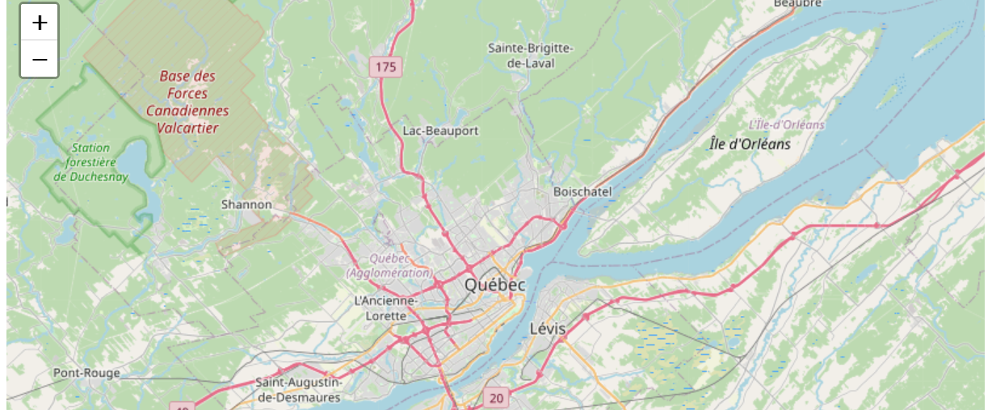
A View Of QUEBEC

Slide 8
Results and Discussion
Quebec is one of the thirteen provinces and territories of Canada, it is located in Central Canada, the province shares land borders with Ontario to the southwest, Newfoundland and Labrador to the northeast, New Brunswick to the southeast, a coastal border with Nunavut, and land borders with the states of Maine, New Hampshire, Vermont and New York to the south.
Quebec has one of the world's largest reserves of fresh water, occupying 12% of its surface.
In general, the climate of Quebec is cold and humid.
Quebec has an advanced, market-based, and open economy.

Slide 9
Conclusion
The purpose of this project, was to suggest a better neighbourhood in a new city for the person who are shifting there.
Social presence in society in terms of like-minded people.
Connectivity to the airport, bus stand, city centre, markets and other daily needs things nearby.
Relevant information was gathered and reported.

Slide 10
THANK YOU

